Slide 1
Supporting Children with Experiences of Trauma
Michelle Deeg-Davis, School Counselor & ACTP
Kelly Beaudry, Special Programs Administrator
Notes:
Community trauma awareness presentation
Introductions (Michelle and Kelly)

Slide 2
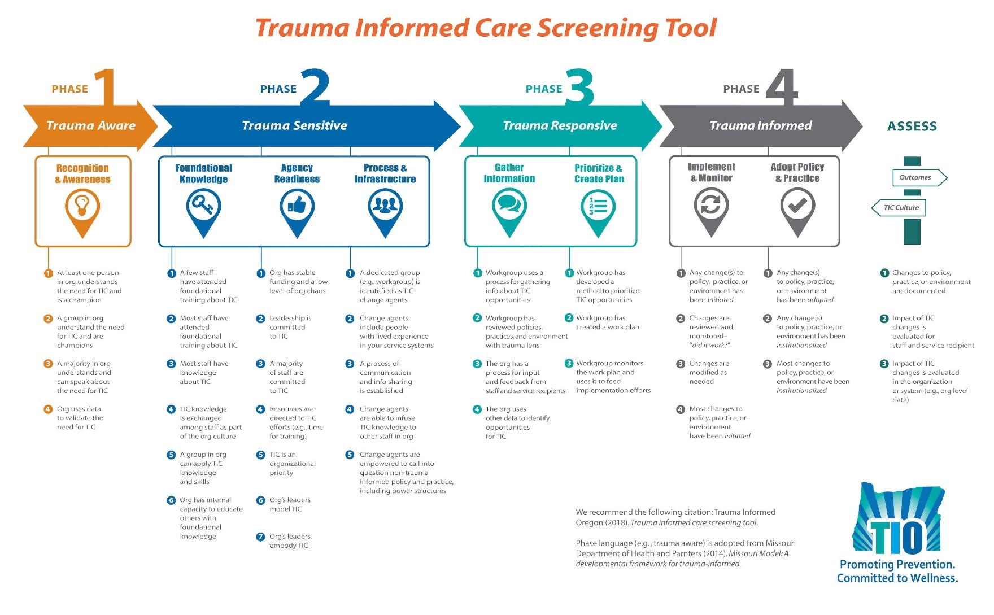
What is Trauma Informed Care?
Notes:
Michelle
Moving from Trauma aware to trauma informed . . . multiple stages. Today = awareness
Awareness-basic knowledge that trauma has a role in behavior, need for more information is understood
Trauma Sensitive-development of systems to support trauma informed practices-training is happening for staff, teams developed, funding secured
Trauma Responsive-Using information to create systems of support for children, using data to support interventions, continued staff development
Trauma Informed-systems are in place to support children, staff are educated in responsive care, policy and practice are consistent and part of the culture of the organization.

Slide 3
What is Trauma?
Trauma is any experience that leaves a person feeling hopeless, helpless, and fearing for their life/survival or safety. This experience can be REAL or PERCEIVED.
Notes:
Michelle
-Cannot assume trauma response will happen
-Perceived-trauma is an experience and symptoms form based on the individual processing that occurs (examples: siblings med. Dx; family all experience a trauma-adult develops symptoms child does not)

Slide 4
Trauma Classification
Type 1-One event
Type 2-One type of event, repeated OR more than one experience
Type 3-Toxic Stress, Developmental Trauma Disorder
Based around frequency, duration and type of traumatic events a child is exposed to.
Notes:
Michelle
Development of the DSM-V proposed diagnostic criteria to include Type 3, due to the developmental problems associated with exposure to traumatic events on a regular basis. These can include cognitive deficits-poor problem solving, lower memory volume, low self-esteem and hopelessness. Ex.fetal exposure to stress hormones

Slide 5
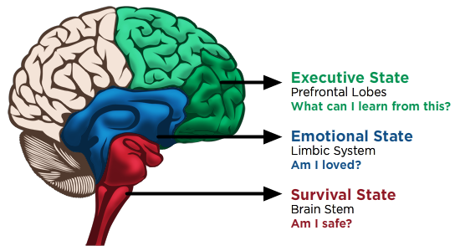
Brain States and Self Regulation
REGULATION
UPSTAIRS Brain
UPSTAIRS Brain
RELATIONSHIPS
ROUTINES
DOWNSTAIRS Brain
Notes:
Michelle (& Kelly make connection to PBIS systems in schools)
Arrows and labels will reveal on click.
Downstairs brain = brain stem and limbic system. It’s the survival brain and emotional brain. Essentially the brain needs to have an affirmative answer to each question before it can move up to the next part of the brain.
Amygdala-located in the limbic system, smoke alarm for threat detection (alerts nervous system to activate)
Hippocampus-stores memory (traumatic memories are created and stored differently due to increased release of stress hormones)
Vagus Nerve-becomes “frozen” when trauma is experienced, activity, human connection is sought to relieve this
Language impact
Mirror Neurons
Trauma is SENSORY not COGNITIVE
Upstairs brain = prefrontal lobes, or ‘executive state’ - this is where we can LEARN.
When this area is activated behavior is a choice, Disconnection results in automatic behaviors
Flight, Fight or Freeze
Labels for 3 R’s:
Routines = establishing safety
Relationships = establishing connection/love
Regulation = reaching the calm, executive state where we can take in new learning

Slide 6
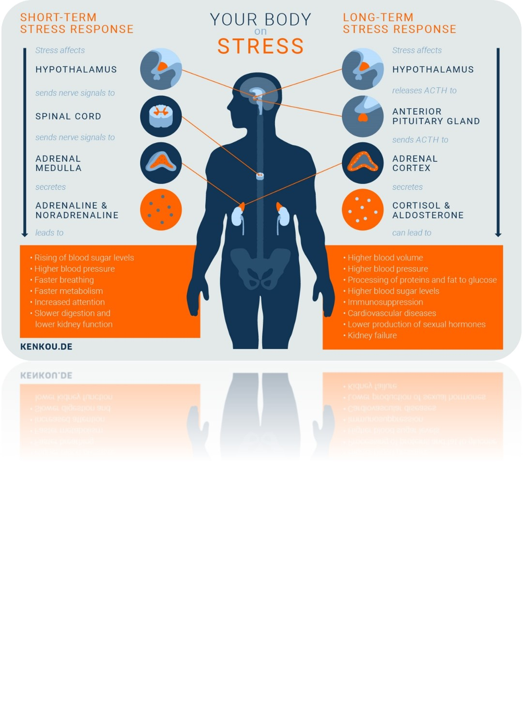
Brain Body Connection
Notes:
Michelle
Short Term-Activation of the Parasympathetic Nervous System
Not only Neurological, whole body involvement-pupils dilate, heart and respiration increase, skin perspiration, digestion inhibited, release of adrenaline, cortisol and norepinephrine and noradrenaline (whole body involvement)
Normal Reaction to Trauma-lasts for 4-6 weeks post trauma,

Slide 7
What is the result of chronic stress in children?
Dissociation
Fractional Identity
Emotional Dysregulation
Notes:
Michelle
D-brains ability to alter consciousness, ex. Rape victim being “outside their body” brain states-cannot escape freeze/collapse
FI-disrupts the identity development, ex. Internal dialog “my parents who love me cannot be bad, I must then be bad”-can be especially prevalent in sexual abuse
ED-mirror neurons, we learn to calm from calm, no reference for calm result in ED

Slide 8
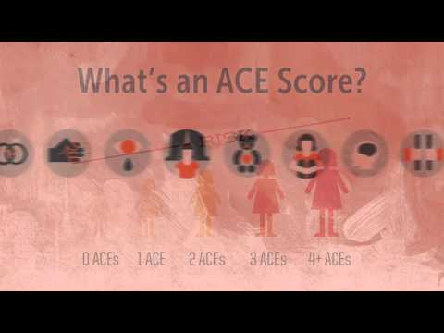
What are ACEs?
Notes:
Kelly
5 minute video on ACEs
https://www.youtube.com/watch?v=ccKFkcfXx-c

Slide 9
National, Oregon, and LCSD ACEs
What parts of the data catch your attention?
How does this data make you feel?
Are there implications for your work with students and families that had not occurred to you before?
Notes:
Kelly
Spend time looking at the data/handouts
The Truth About ACEs (nation-wide data)
Oregon data
Adverse Childhood Experiences (Linn, Benton, and Lincoln Counties)
Have a table-top discussion, and then a few group share-outs. Possible discussion prompts:
How does this data make you feel?
What parts of the data catch your attention?
Are there implications for your work that had not occurred to you before?

Slide 10
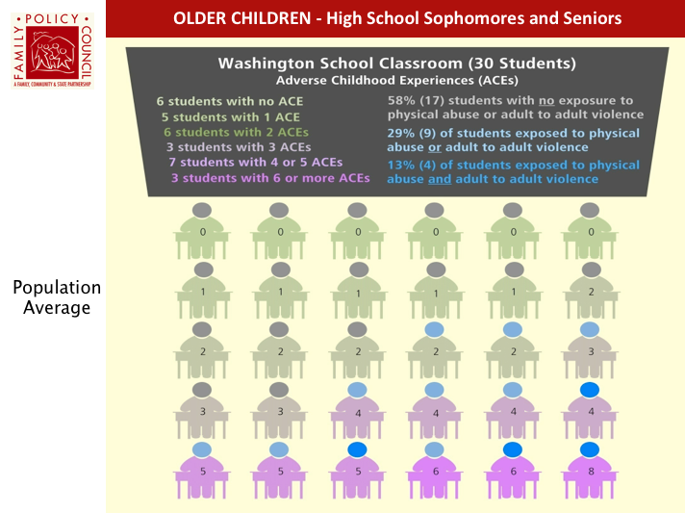
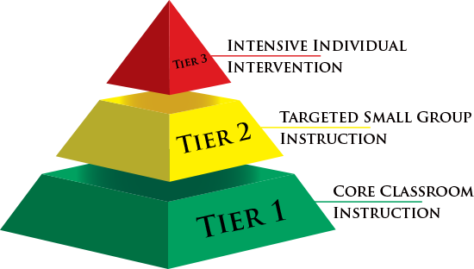
Trauma and our School Systems
<5%
<20%
80%+
Notes:
Kelly
Schools systems (PBIS) Trauma-informed practice is ALL our jobs! (Make connections here to what school is working on in Tier 1 already)
The high percentage of ACEs in our student population means we don’t need to know everyone’s ACE score - we can make accurate assumptions that it’s much more than 20% of our students, so this makes it absolutely necessary that we take a universal/core/Tier 1 approach to addressing the issue.

Slide 11
Notes:
Michelle
A person (or a school population) is not their ‘ACEs’ score - there are many factors that contribute to an individual’s success.
ACEs are greatly impacted by factors such as age, number, source, frequency, duration and intensity of adverse events
They can be buffered by protective factors, resilience, Social-Emotional skills, relationships, stability, etc.

Slide 12
4 Main Protective Factors for Resilient Children
Supportive adult-child relationships.
A sense of self-efficacy and perceived control.
Adaptive skills and self-regulatory capacities.
Sources of faith, hope and cultural traditions.
Notes:
Michelle
-resiliency brings hope, this is where we can bring change

Slide 13
Circle of Courage Resiliency Model
Notes:
Michelle

Slide 14
What is Trauma Informed Care?
Notes:
Michelle
Moving from Trauma aware to trauma informed . . . multiple stages. Today = awareness
Take away=building knowledge of traumas impact on the brain and behavior, implications for future support.

Slide 15
Next Steps
Book & Feedback Card
6-Hour Training: ‘Children of Trauma and Resilience’
Notes:
Show book and exit ticket, have them give name and address for mailing to them, get feedback from them on participation in 6-hour workshop

